Slide 1

Course: Digital Image Processing
By: Dr. Muhammad Fayaz
Department of Computer Science, University of Central Asia

Slide 2
RECAP
What is an Image?
Representation of an Image
Types of Images
Binary Image
Grayscale Image
RGB Image
Image Sampling and Quantization
Spatial Resolution
Libraries
Relationship Between Pixels
Neighborhoods: N₄, N_{D}, and N₈
Adjacency: N₄, and N_{8 ,} and Mix-adjacency
Distances: N₄ (City Block Distance), and N₈ (Chess Board Distance)
Region, Boundary, and Edge
Types of Image Enhancement Operations
Min-Max Marching
Histogram Equalization

Slide 3
Convolution
Operation

Slide 4
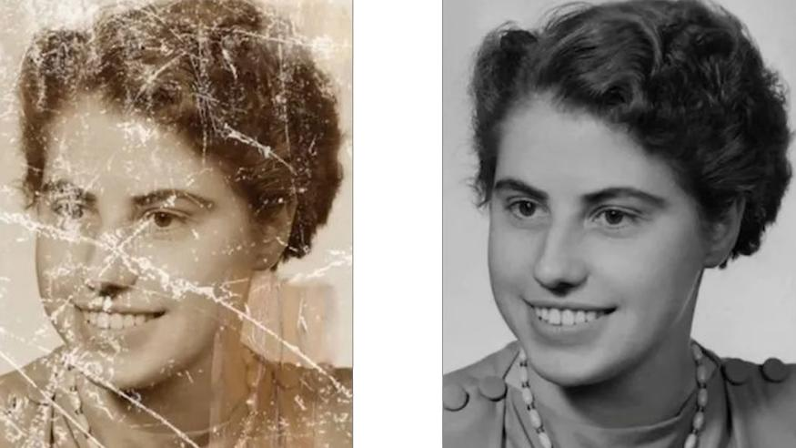
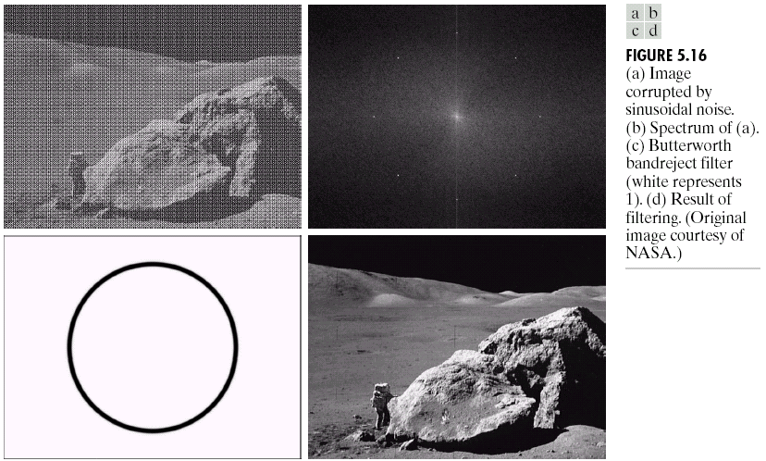
Image Restoration
Image Restoration
Morphological Processing
Image Enhancement
Segmentation
Image Acquisition
Object Recognition
Representation & Description
Problem Domain
Colour Image Processing
Image Compression

Slide 5
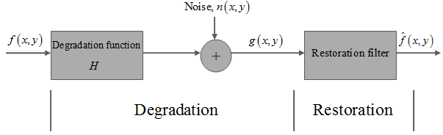
Image Restoration and Image Degradation Model
Image restoration is a restoring or recovering process of a degraded image by utilizing some prior knowledge of the degradation method which has degraded the image.
So, the image restoration process involves the estimation of the deteriorated model as well as the relevance of the inverse filtering to restore or retrieve the original image.
Although the reconstructed image may not be the exact form of the original image, it will be the approximation of the original image.
Figure 1 below shows a fundamental model of image degradation and restoration procedure.

Slide 6
Image Restoration and Image Degradation Model
We can restore the image in spatial domain as well as in frequency domain (we will do this later)
In spatial domain, the degradation of the original image can be modelled as:
g(x,y) = h(x,y)∗ f(x,y) + n(x,y)
Where,
(x,y)= detached pixel coordinates of the image frame.
f(x,y)= Original image
g(x,y)= Degraded image
h(x,y)= Image degradation function
n(x,y)= Ad-on noise

Slide 7
What is Nois in Image Processing?
Noise in image processing refers to unwanted variations or distortions in the pixel values of an image.
It can result from various sources during image acquisition, transmission, or processing.
Noise can degrade image quality, reduce the accuracy of analysis, and make images less visually appealing.
Understanding and mitigating noise is a crucial aspect of image processing and computer vision.
Causes of Noise: Noise can originate from various sources, such as sensor limitations, electronic components, transmission errors, poor lighting conditions, and imperfections in imaging systems.
Impact of Noise: Noise can reduce the contrast and clarity of images, making it challenging to discern fine details. It can also impact the accuracy of image analysis algorithms and computer vision tasks.

Slide 8
What is Nois in Image Processing?
Noise in image processing refers to unwanted variations or distortions in the pixel values of an image.
It can result from various sources during image acquisition, transmission, or processing.
Noise can degrade image quality, reduce the accuracy of analysis, and make images less visually appealing.
Understanding and mitigating noise is a crucial aspect of image processing and computer vision.
Causes of Noise: Noise can originate from various sources, such as sensor limitations, electronic components, transmission errors, poor lighting conditions, and imperfections in imaging systems.
Impact of Noise: Noise can reduce the contrast and clarity of images, making it challenging to discern fine details. It can also impact the accuracy of image analysis algorithms and computer vision tasks.

Slide 9
What is Nois in Image Processing?
The presence of noise in an image might be additive or multiplicative.
In the Additive Noise Model, an additive noise signal is added to the original signal to produce a corrupted noisy signal that follows the following rule:
w(x, y) = s(x,y) + n(x,y)
Here, s(x, y) represents the original image intensity and n(x,y) represents the noise supplied to produce the corrupted signal w(x,y) at (x,y) pixel position.
Similarly, the Multiplicative Noise Model multiplies the original signal by the noise signal.

Slide 10
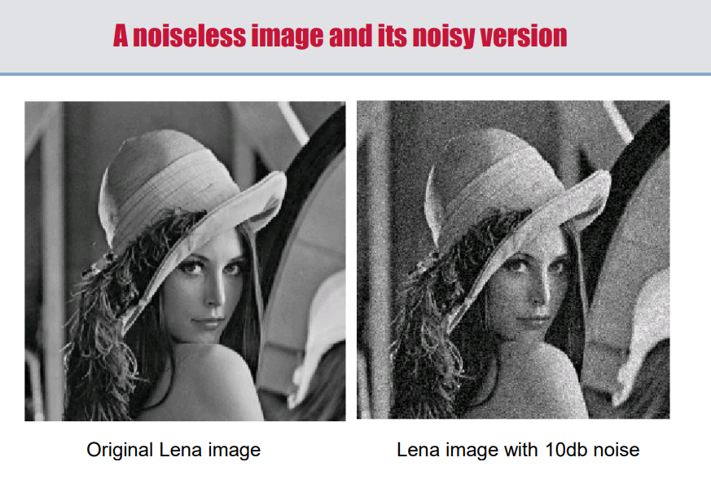
What is Nois in Image Processing?
Different Types of Noise: There are different types of Noise
Gaussian Noise
Salt and Pepper Noise/Impulse Noise
Speckle Noise
Poison Noise

Slide 11
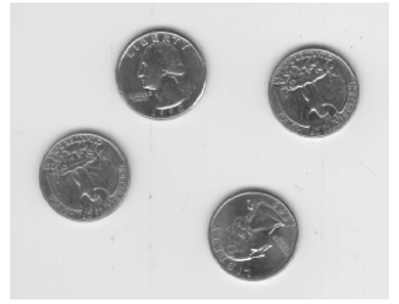
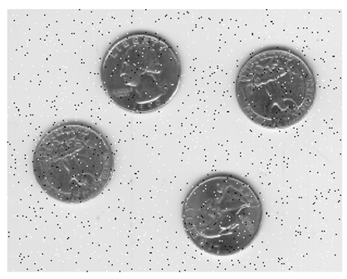
Types of Noise:
Salt-and-pepper/Impulse Noise: Salt and pepper noise manifests as random white and black pixels in an image.
It simulates random errors and can disrupt the overall visual quality of an image.
Salt and pepper noise is often caused by various factors such as errors in data transmission, sensor malfunction in digital cameras, or issues during image acquisition and processing.
It can significantly degrade the quality of an image and make it harder to interpret or analyse.

Slide 12
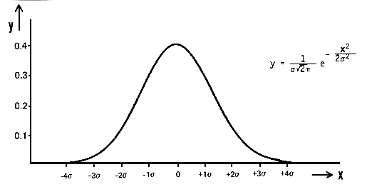

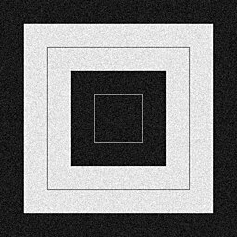
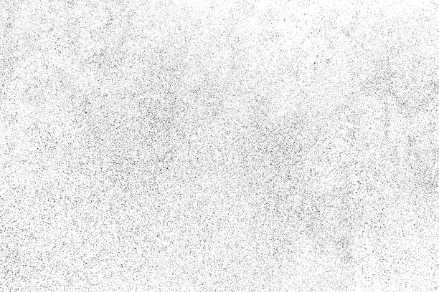
Types of Noise:
Gaussian Noise: Gaussian noise is a type of noise that follows a Gaussian or normal distribution.
It often appears as random variations in pixel values, introducing a subtle grainy appearance.
Gaussian noise arises in an image due to factors such as electronic circuit noise and sensor noise due to poor illumination or high temperature.

Slide 13
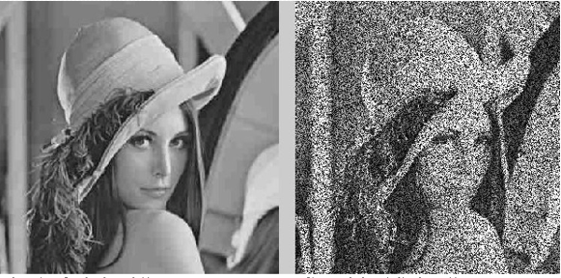
Speckle Noise:
Speckle Noise" is a type of noise commonly found in digital images, particularly in radar and ultrasound imagery.
It appears as a grainy pattern of bright and dark pixels that can obscure the details of an image.
This noise is caused by various factors including the random interference of signals during the image acquisition process
Speckle noise is different from other types of noise, like Gaussian noise or salt and pepper noise, because it's characterized by a granular appearance with a fine texture.
It's often challenging to remove without losing important image details.

Slide 14
Convolution
In image processing, convolution is a fundamental operation used for various tasks, including filtering, feature extraction, and image enhancement.
It involves applying a convolution kernel (also known as a filter or mask) to an image to perform operations like blurring, sharpening, edge detection, and more.
Here's how convolution works in image processing:
1. Convolution Kernel:
A convolution kernel is a small matrix (usually square) that defines the operation to be applied to the image.
The size of the kernel can vary depending on the specific task.
For example, a common size for image blurring is a 3x3 or 5x5 kernel.
2. Sliding Window:
To apply convolution, you take the convolution kernel and place it over a region of the image.
The kernel is then "slid" or moved across the entire image, one position at a time. At each position, an operation is performed.

Slide 15
Convolution
3. Element-wise Multiplication and Summation:
At each position, the convolution operation involves element-wise multiplication between the kernel and the corresponding region of the image beneath it.
The results of these multiplications are summed up to produce a single value.
This value is usually placed in the corresponding position of the output (resulting) image.
4. Boundary Handling:
Handling image boundaries is important during convolution.
Depending on the specific approach, different methods can be used, such as zero-padding, reflecting the image at the boundaries, or cropping the output to ensure it matches the input image size.

Slide 16
Convolution
Applications of Convolution in Image Processing:
Blurring: Convolution with a blur kernel is used to reduce image noise and make the image smoother.
Sharpening: Convolution with a sharpening kernel enhances edges and fine details in the image. It increases the contrast of the image.
Edge Detection: Convolution with edge detection kernels, such as the Sobel or Prewitt operators, highlights edges and boundaries in the image.
Feature Extraction: Convolutional filters in deep learning models (Convolutional Neural Networks or CNNs) are used to extract features from images. These filters are learned from data and can capture various image patterns.
Object Detection: In computer vision tasks like object detection, convolutional layers are used to scan an image at multiple scales to identify objects and their locations.

Slide 17
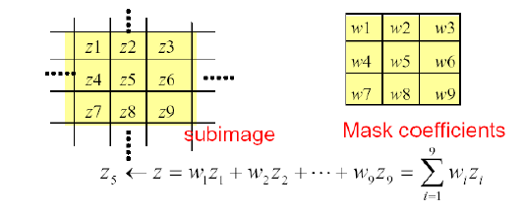
Basics of Spatial Filtering
Given the 3×3 mask with coefficients: w₁, w₂,…, w₉
The mask covers the pixels with gray levels: z₁, z₂,…, z₉
z gives the output intensity value for the processed image (to be stored in a new array) at the location of z₅ in the input image

Slide 18

Convolutional
Filter =$\left[\begin{matrix}1 & 0 & 1 \\ 0 & 1 & 0 \\ 1 & 0 & 1\end{matrix}\right]$

Slide 19
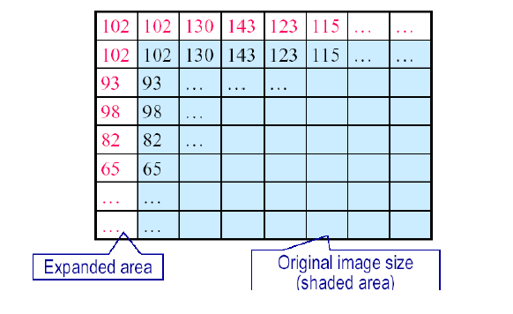
Padding
Padding is a term relevant to convolutional as it refers to the number of pixels added to an image when it is being processed by the kernel/filter.
Padding is used to obtain the image of original size.
Following are some types of Padding

Slide 20
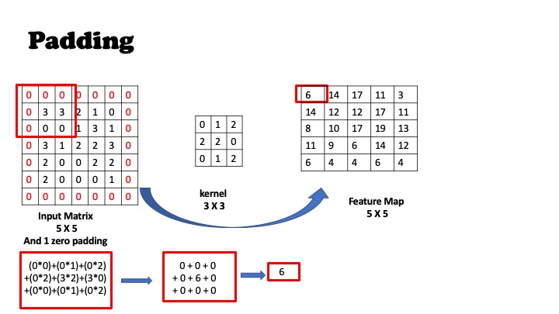
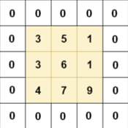
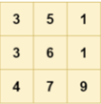
Convolution
Same Padding/Zero Padding: In this type of padding, the padding layers append zero values in the outer frame of the images or data so the filter we are using can cover the edge of the matrix and make the inference with them too.
Zero padding is not good; creates artificial lines or edges on the border

Slide 21
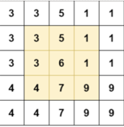
Convolution
Replication Padding: Replication padding which replicate the pixels value in additional row and column on each side of the image

Slide 22
Noise Reduction
Noise reduction refers to the various methods and techniques used to enhance the quality of digital images by reducing unwanted noise while preserving important image features.
Spatial Filters
Linear Filter
Mean/Box Filters
Weighted Average
Median Filter
Max Filter
Min Filter
Non-Linear Filter/
Order Statistics Filters
Low Pass Filters
High Pass Filters
The Laplacian Filter
Smoothing Filters

Slide 23
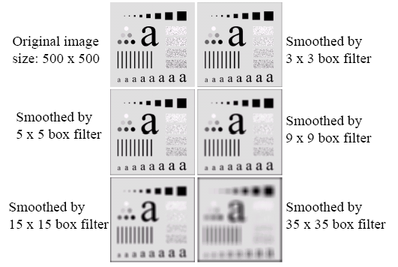
Spatial Filtering for Smoothing (Example)

Slide 24
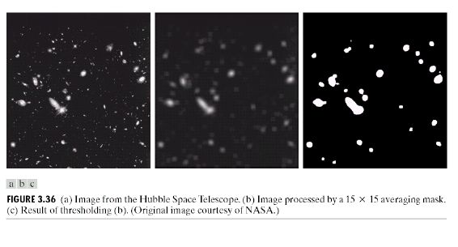
Spatial Filtering for Smoothing (Example)

Slide 25
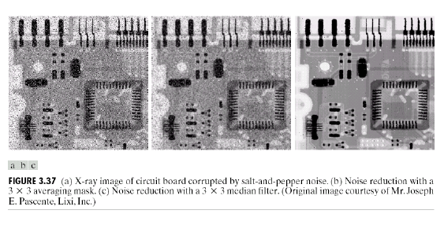
Median Filtering (Example)

Slide 26
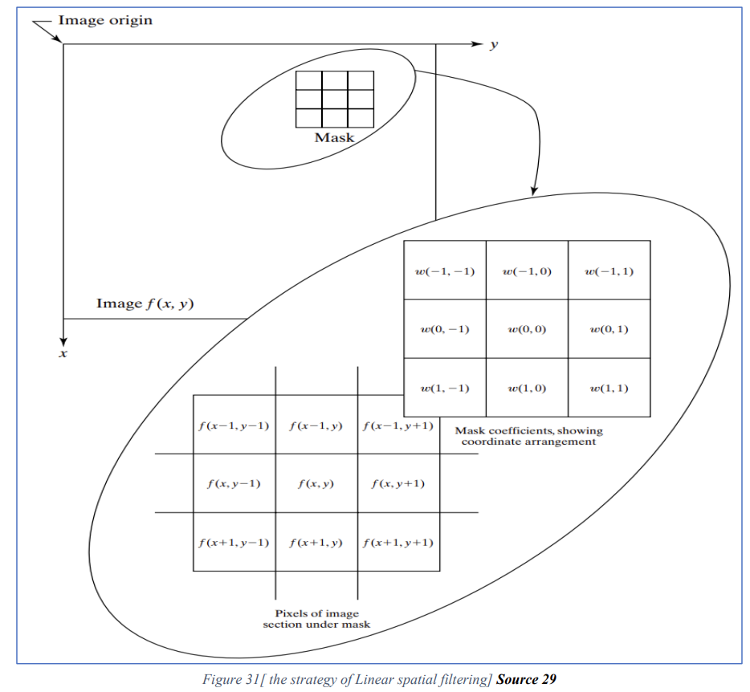
Spatial Filtering
Linear Filters: Operation consists of multiplying each pixel in the mask by corresponding element in the neighborhood, and adding up all these products

Slide 27

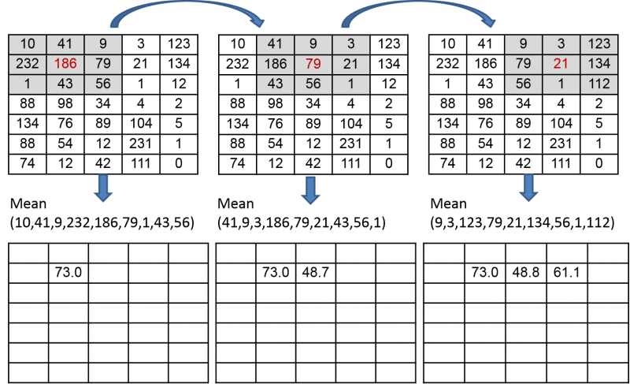
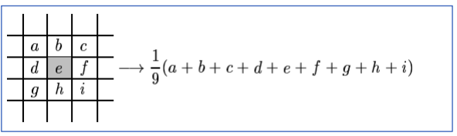
Mean/Averaging Filter
Average (or mean): filtering is a method of 'smoothing' images by reducing the amount of intensity variation between neighboring pixels.
The average filter works by moving through the image pixel by pixel, replacing each value with the average value of neighboring pixels, including itself.

Slide 28
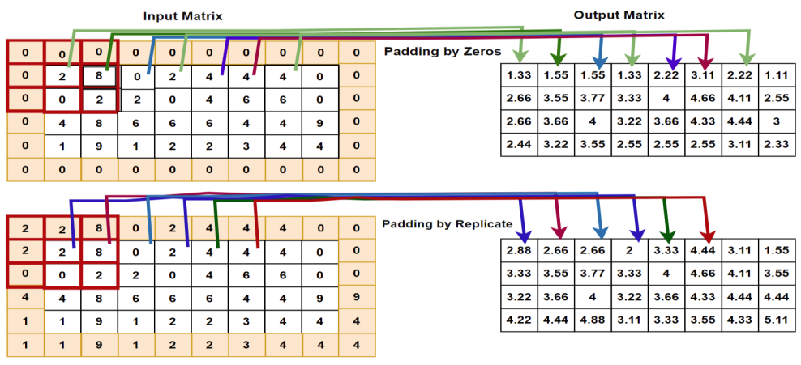
Mean/Averaging Filter

Slide 29
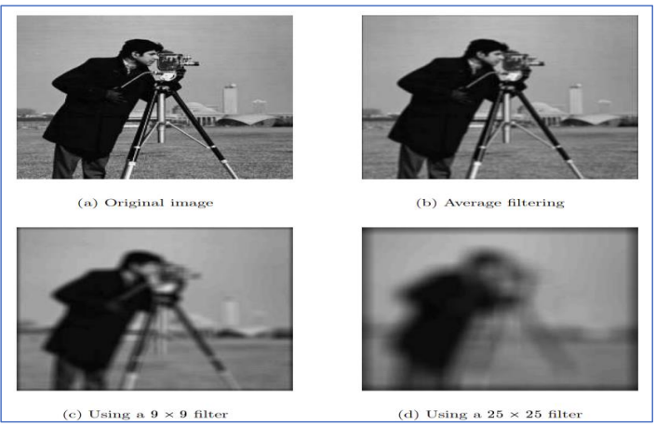
Mean/Averaging Filter

Slide 30
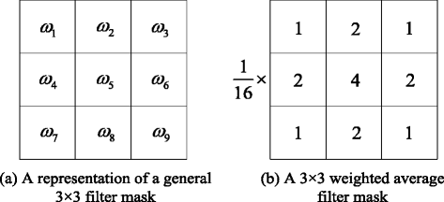
Weighted Average Filter
In weighted average filter, we gave more weight to the centre value, due to which the contribution of centre becomes more than the rest of values.
Due to the weighted average filtering, we can control the blurring of image.

Slide 31
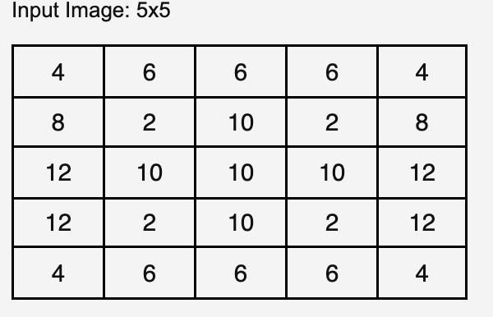
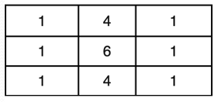
Weighted Average Filter

Slide 32
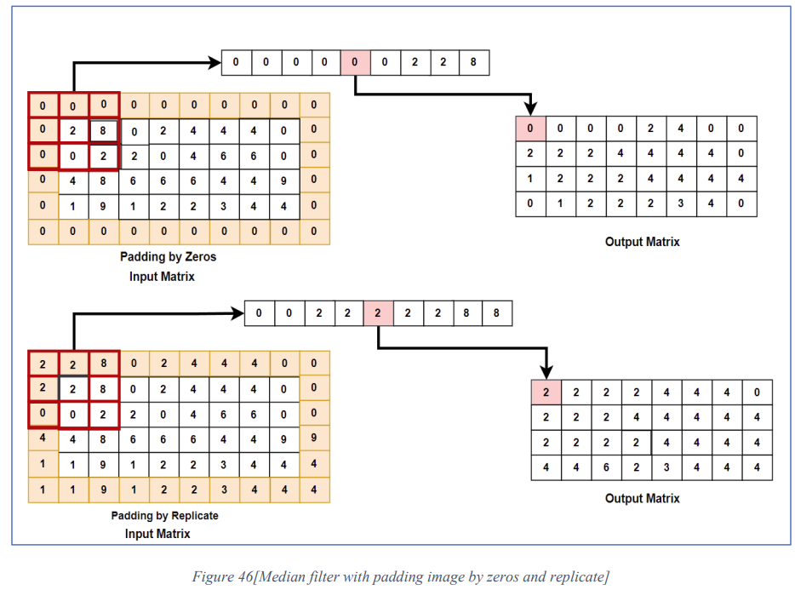
Median Filter
Median Filter with padded image

